Slide 1
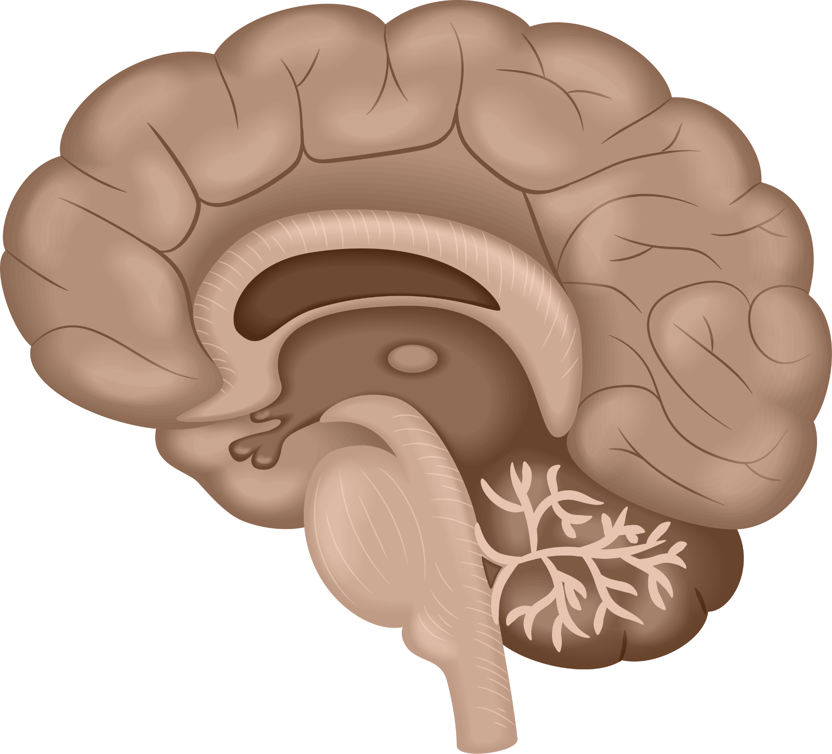

Low-Grade Glioma Segmentation
Prepared By Eda AYDIN

Slide 2

Table of contents
01
02
03
My Journey
Business
Understanding
Data
Understanding
04
05
06
Data
Augmentation
Modeling
Data
Visualization
07
08
09
Evaluation
Core Skills
Conclusion

Slide 3
01
My Journey

Slide 4
My Journey
B.Eng. in Computer Engineering
2014 - 2019
Micro Master in Artificial Intelligence - Neural Engineering Program
2021 - Present
Graduate Research Student in AI for Neuroscience 2021- Present
UpSchool - Google Developers
ML Program
2022- Present
Got a job as an Artificial Intelligence Intern
2019

Slide 5
02
Business Understanding

Slide 6
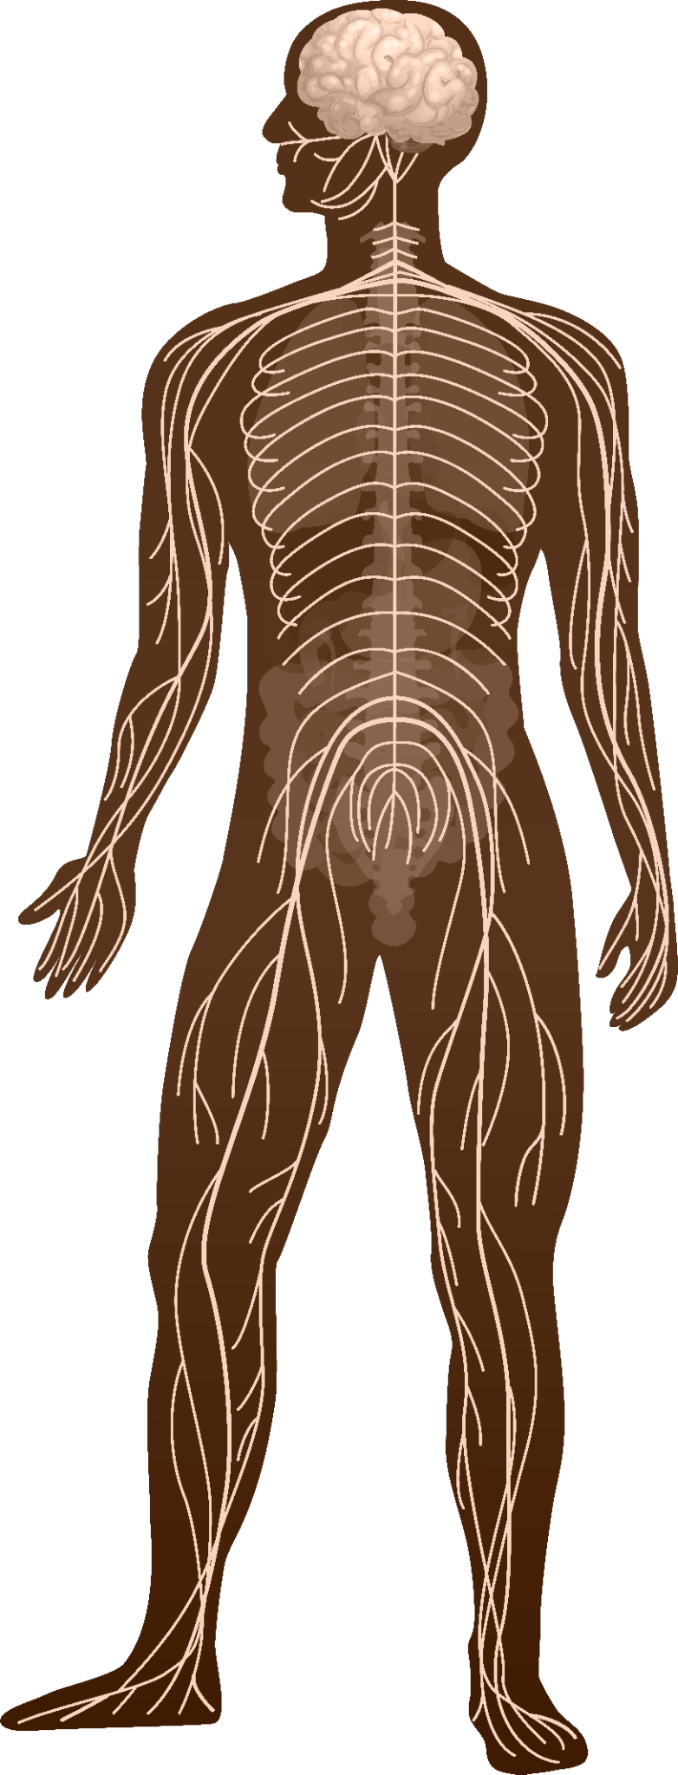
What is the Low-Grade Glioma?
A type of brain tumor is classified as a grade II and III tumor
Arises from the supporting cells of the brain called glial cells
Generally benign
Cause significant neurological symptoms
Pressure on the surrounding brain tissue
Most common in adults, but also occurs in children
Treated with surgery, radiation therapy

Slide 7
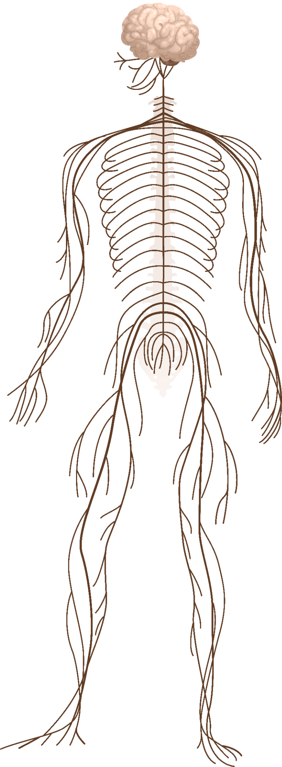
Why deep learning should be used?
Allows for the accurate identification of tumor boundaries in MRI scans.
Without deep learning, time-consuming
Can be challenging due to the infiltrative nature
Leading to potential misdiagnosis
Improve efficiency and accuracy

Slide 8
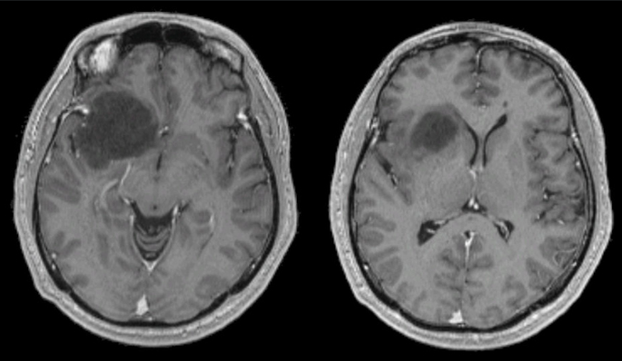
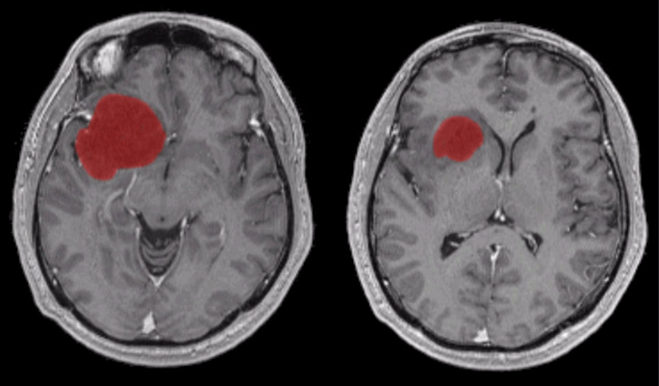
Example of Low-Grade Glioma
Without Segmentation
With Segmentation

Slide 9
03
Data Understading

Slide 10
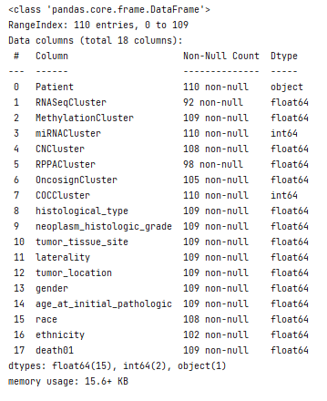
Data Information
Obtained from The Cancer Imaging Archive (TCIA)
Contains Brain MRI images with manual FLAIR abnormality segmentation masks
110 patients
CSV dataset
110 rows – 18 columns

Slide 11
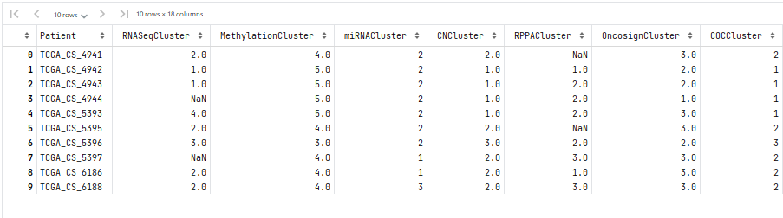
Taking a look at dataset

Slide 12
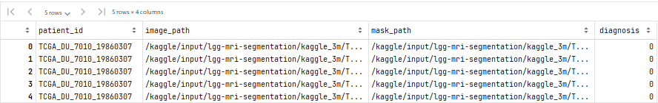
Creating the new dataset

Slide 13
04
Data Visualization

Slide 14
04.1
Distribution

Slide 15
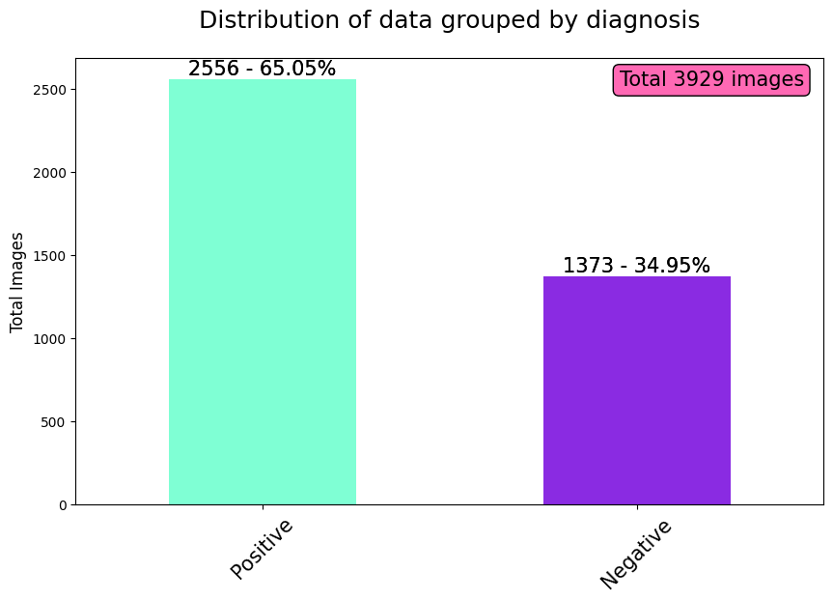
Distribution

Slide 16
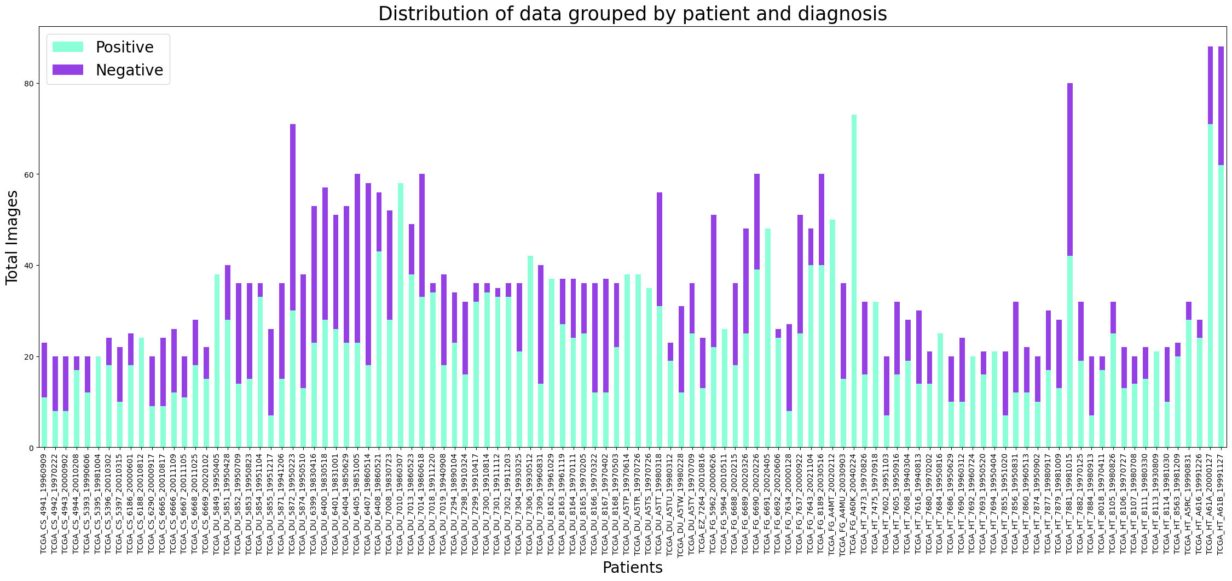
Distribution of data grouped by patient and diagnosis

Slide 17
04.2
Visualization of Brain MRI Images

Slide 18
Why is the hot-colormap important?
Highlight different tissue types in the brain based on their MRI intensities
Low-intesity values to dark colors (black)
High-intensity values to bright colors (red, yellow, and white)
Distinguish different structures in the brain such as grey matter, and white matter.
Differentiating between healthy and abnormal tissue, such as tumors.

Slide 19
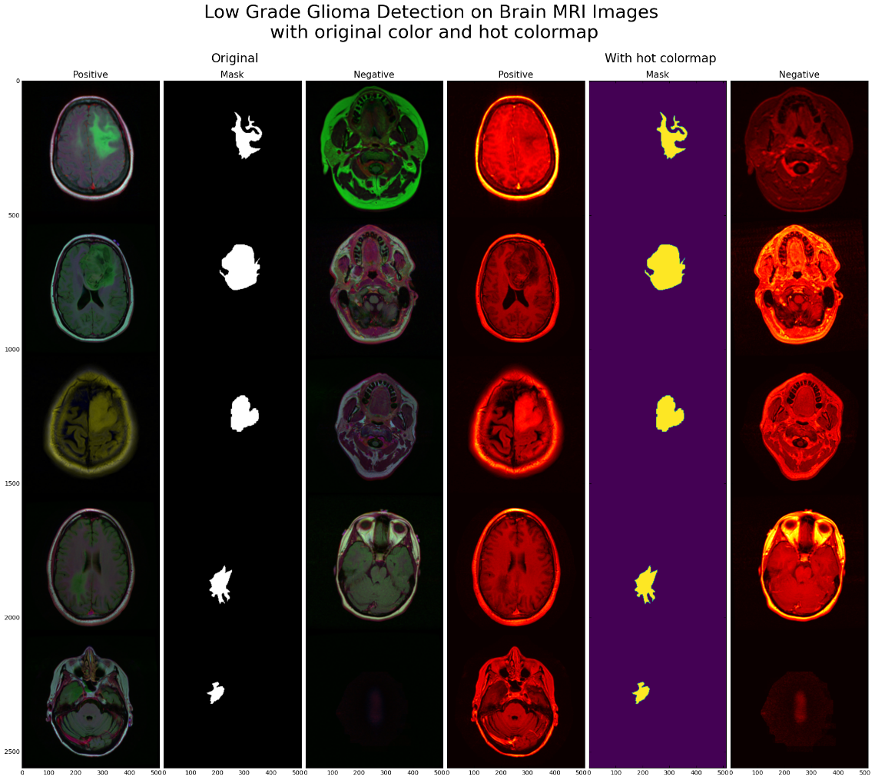
Low-Grade Glioma on Brain MRI Images with original color and hot colormap

Slide 20
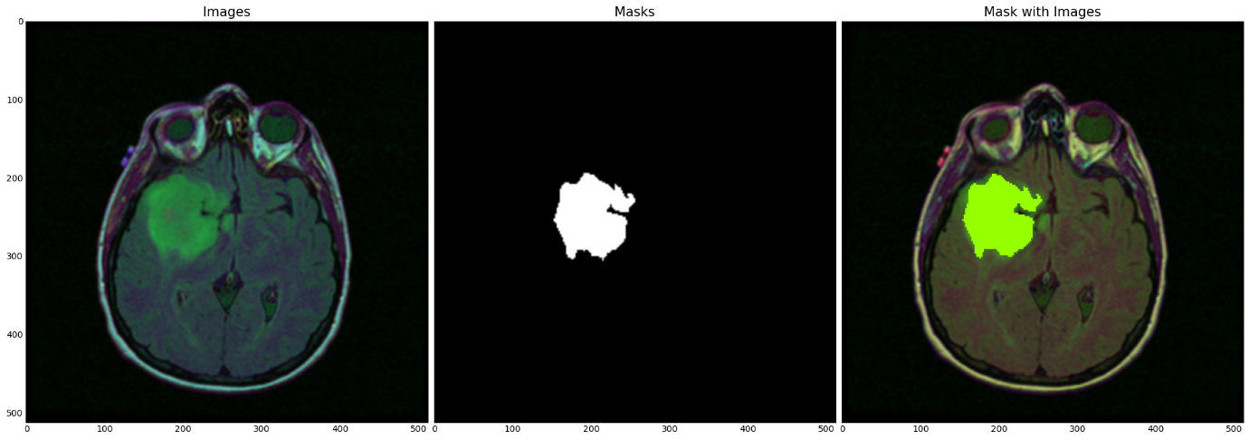
Tumor location is shown as segmented on a Brain MRI Images

Slide 21
05
Data Augmentation

Slide 22
Why the Albumentations library is important?
Wide range of image segmentation techniques that can be applied to medical images
Easy composition of multiple augmentations together
Techniques
Elastic information | Grid - Optical Distortion
Brightness,
Constrant changes
Random rotation

Slide 23
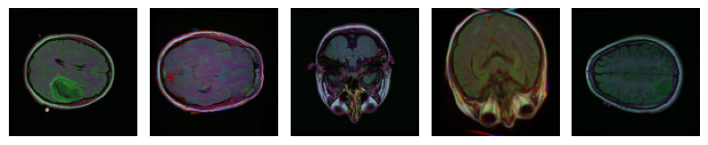

Augmented Brain MRI and Mask Images

Slide 24
06
Modeling

Slide 25
Why PyTorch instead of TensorFlow?
Easier to work with the Albumentation library and for complex tasks such as segmentation
Dynamic computational graphs
Models need to adapt to different input shapes and sizes.

Slide 26
Model Information and Decision
Feature Pyramid Network (FPN)
U-Net
ResUNet
A specific type of FCN that is designed for biomedical image Segmentation
Composed of an encoder and a decoder
Widely used in brain tumor segmentation
A type of deep neural network architecture that is designed for object detection and semantic segmentation
Top of CNN
Pyramid of feature maps
A type of CNN that used residual connections between layers to allow the network
UNet + ResNet

Slide 27
Models Architecture
Feature Pyramid Network (FPN)
U-Net
ResUNet
15 convolutional
14 rectified linear units (ReLU)
3 max-pooling layers
3 up-sampling layer
18 convolutional
10 rectified linear units (ReLU)
5 max-pooling layers
1 top-down layer
3 sampling addition layers
3 smooth layers
1 up-sampling layer
Pretrained model (ResNet50-32x4d model)
5 down-sampling layers
4 up-sampling layers
2 convolutional
1 rectified linear unit (ReLU)
Note: Dice Coefficient Metric is used as the Segmentation quality metric.
Dice Coefficient Loss is used as the Segmentation loss.

Slide 28
07
Evaluation

Slide 29
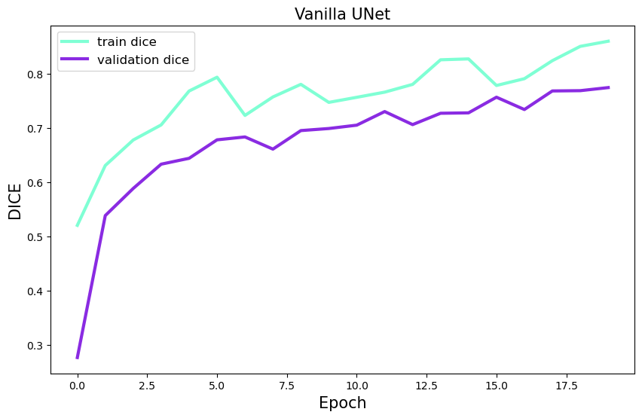
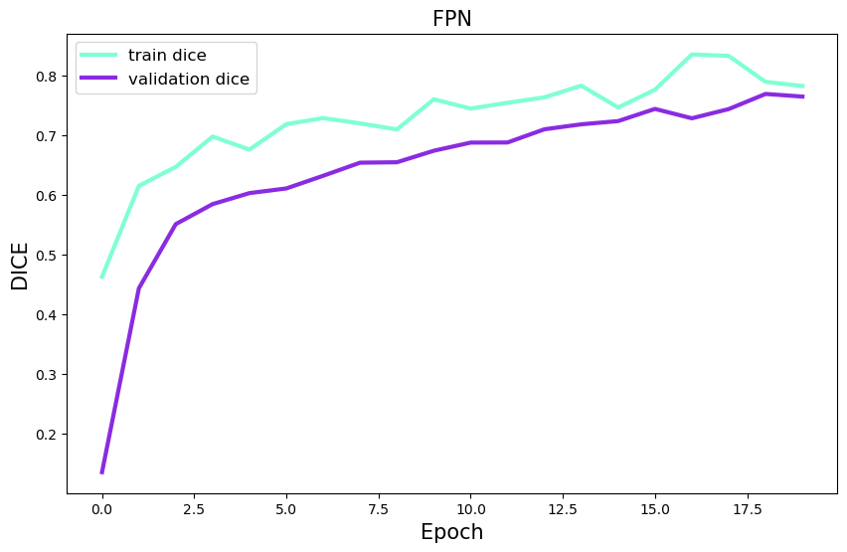
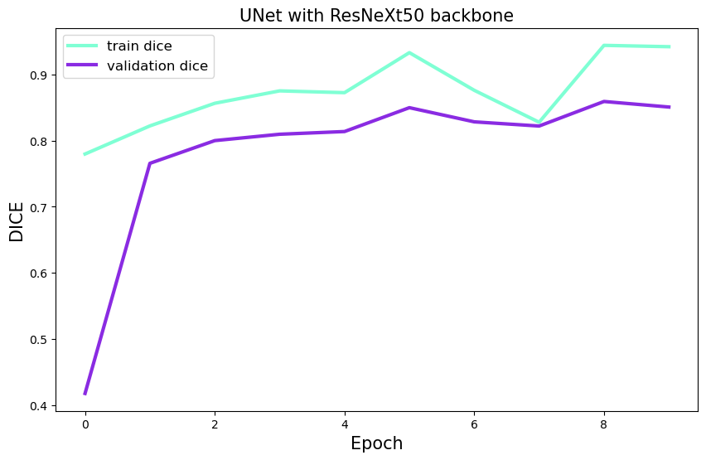
Evaluation of the Model Architectures on Training and Validation Data
Feature Pyramid Network (FPN)
U-Net
ResUNet

Slide 30
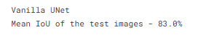
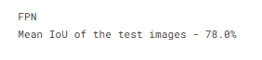
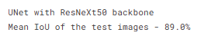
Evaluation of the Model Architecture on Test Data
U-Net
Feature Pyramid Network (FPN)
ResUNet

Slide 31
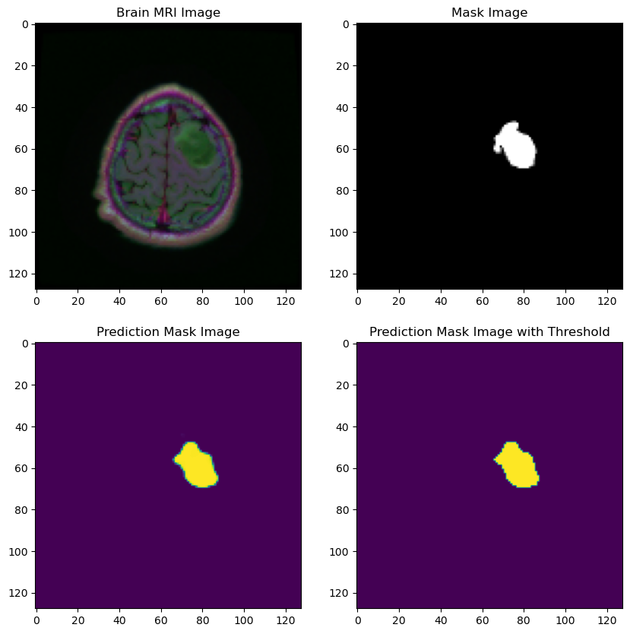
Evaluation of the Random Test Sample

Slide 32
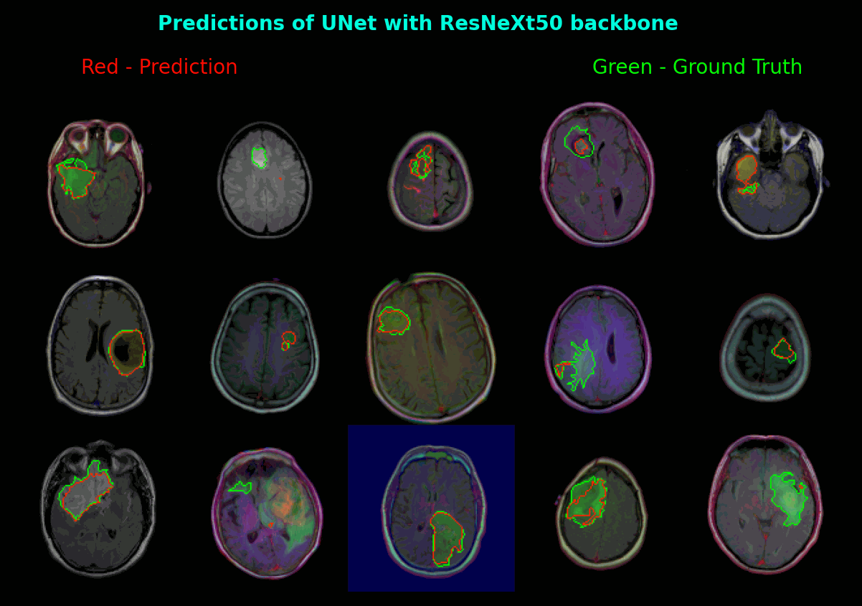
Evaluation of the Prediction and Ground Truth Masks on the Brain MRI Images

Slide 33
08
Core Skills

Slide 34
Core Skills
Resillience
Self-compassion
Time Management
Soft Skills I gained
Teamwork
Sisterhood
Communication
Soft Skills we gained as a group

Slide 35


Slide 36
09
Resources

Slide 37
Articles
Automatic Segmentation and Shape, Texture-based Analysis of Glioma Using a Fully Convolutional Network
Low-grade gliomas
Fluid-Attenuated Inversion Recovery Magnetic Resonance Imaging Detects Cortical and Juxtacortical Multiple Sclerosis Lesions
Association of genomic subtypes of lower-grade gliomas with shape features automatically extracted by a deep learning algorithm
Data Augmentation for Brain-Tumor Segmentation
Brain tumor image segmentation using Deep learning
Comparison of Jaccard, Dice, and Cosine Similarity Coefficient To Find Best Fitness Value
Albumentations: Fast and Flexible Image Augmentations

Slide 38
Blog Posts - Slides
Feature Pyramid Network (Object Detection)
A Unified Architecture for Instance and Semantic Segmentation
Understanding Feature Pyramid Networks for object detection (FPN)
Carvana Image Masking Challenge–1st Place Winner’s Interview

Slide 39
Websites
LGG-1p19qDeletion - The Cancer Imaging Archive (TCIA) Public Access
Albumentations Documentation
Papers with Code - U-Net Explained
Papers with Code - Brain Tumor Segmentation
Deep learning-based skull stripping and FLAIR abnormality segmentation in brain MRI using U-Net
Brain MRI | Data Visualization | UNet | FPN
BrainMRI|UNet|FPN|ResNeXt50
Brain MRI Detection | Segmentation | ResUNet
Brain MRI Segmentation

Slide 40




Thank you!

